Slide 1
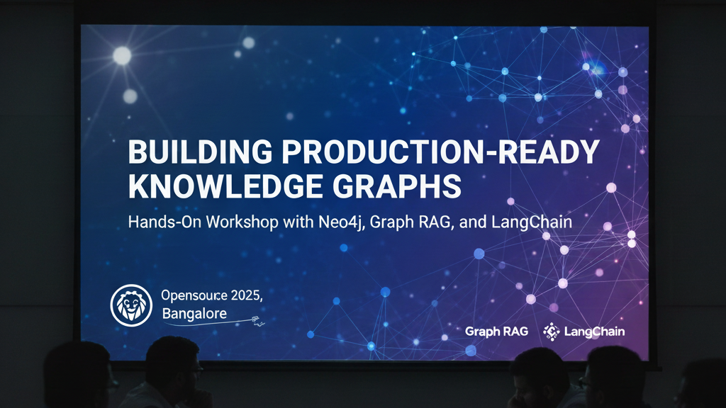

Slide 2

About Me
Manjunath Janardhan, Principal AI Engineer at MSG Global
21+ years of software engineering experience
Key expertise areas: AI, Microservices & Cloud.
Patent Holder
Speaker, Medium Articles, YouTuber, Neo4j Ninja
Notes:
This slide serves as an introduction to my professional background and journey. I will cover my educational background, work experiences, and the skills I've developed. Additionally, I will share my interests and passions within the industry. The LinkedIn QR code will facilitate networking, and the portfolio link will provide insights into my work and projects.

Slide 3

Agenda
Graph Database
Vector Database
RAG and GraphRAG
HybridRAG
Langchain
Live Workshop

Slide 4
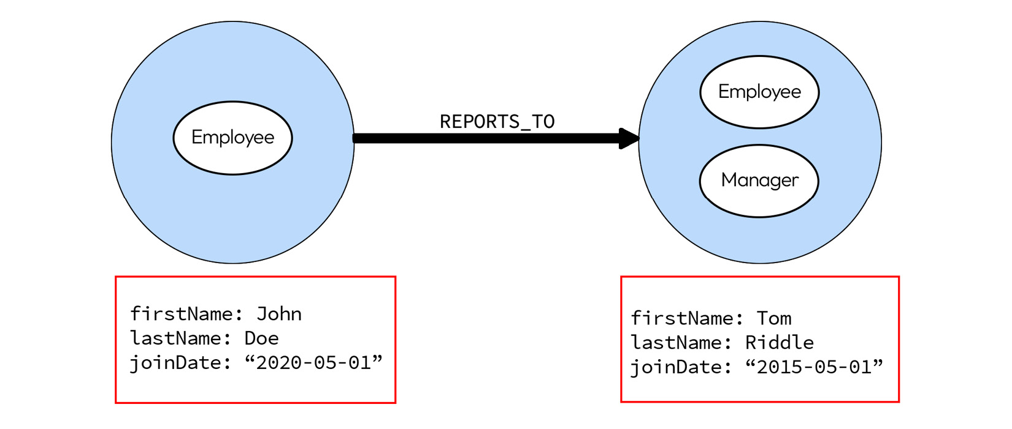

Slide 5
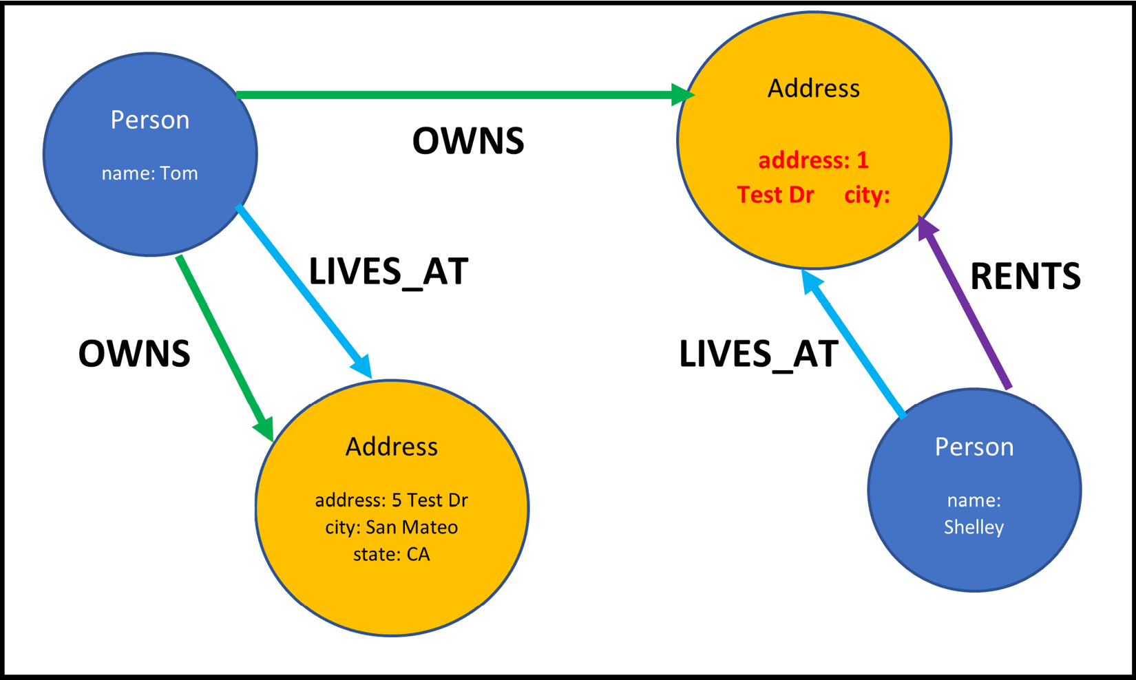
Sample graph data diagram

Slide 6
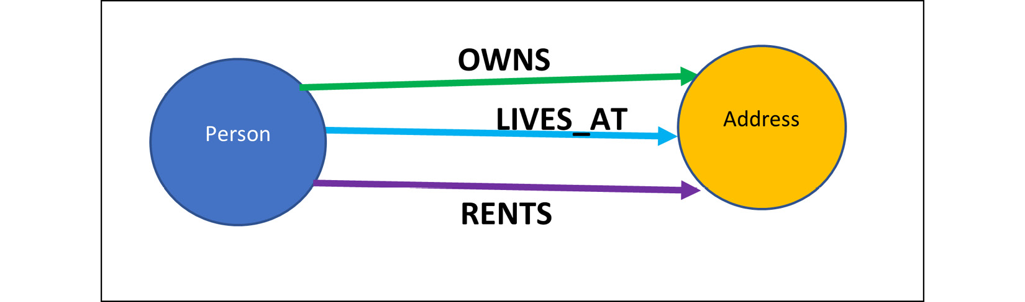
Sample graph data model

Slide 7
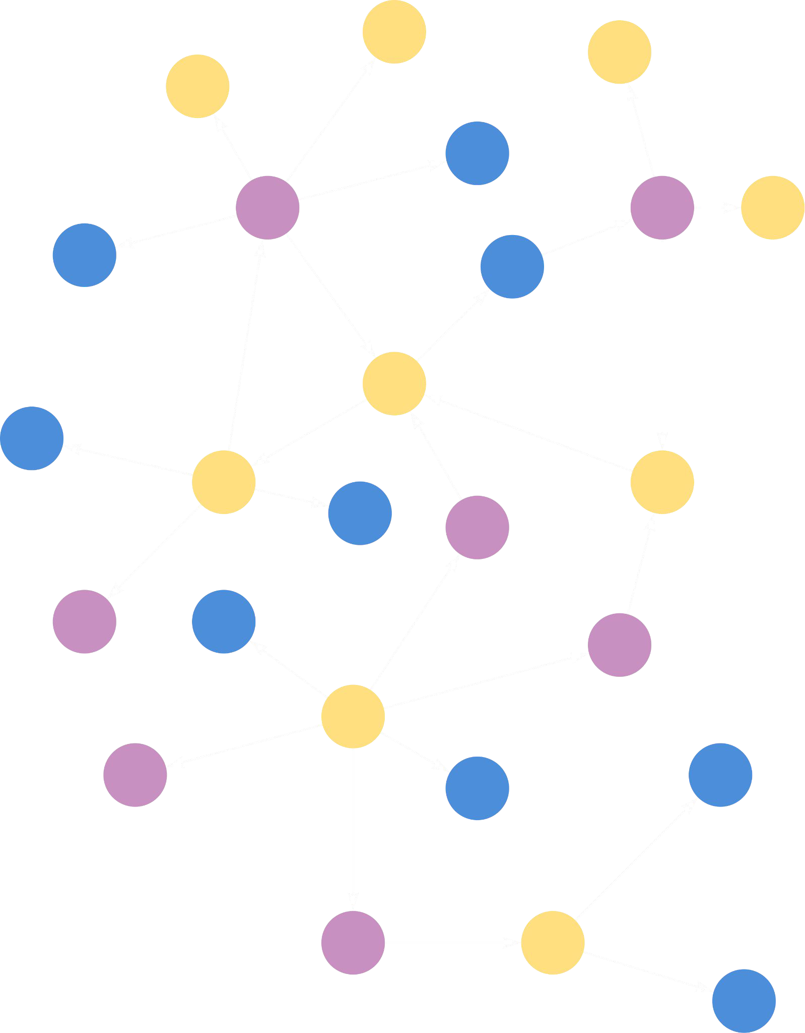


Knowledge graphs = design pattern to organize & access interrelated data
Property Graph Data Model
Connected Data
BROTHER_OF
Person
Name:Terry
Person
Name:Sam
Node
SISTER_OF
Relationship
OWNS
DRIVES
Since:10/Feb/11
Since:10/Jan/11
Property
Car
Brand:Volvo

Slide 8
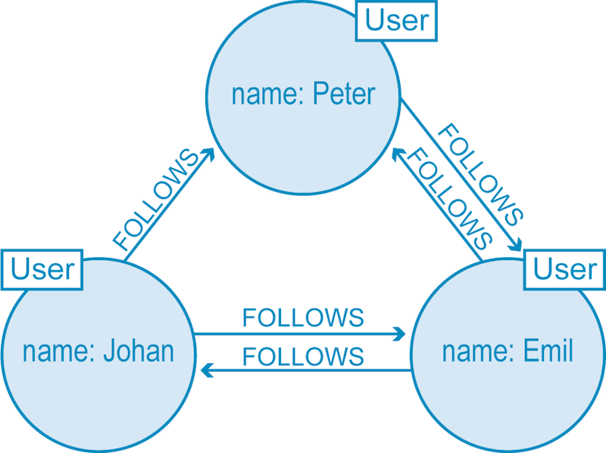

Slide 9
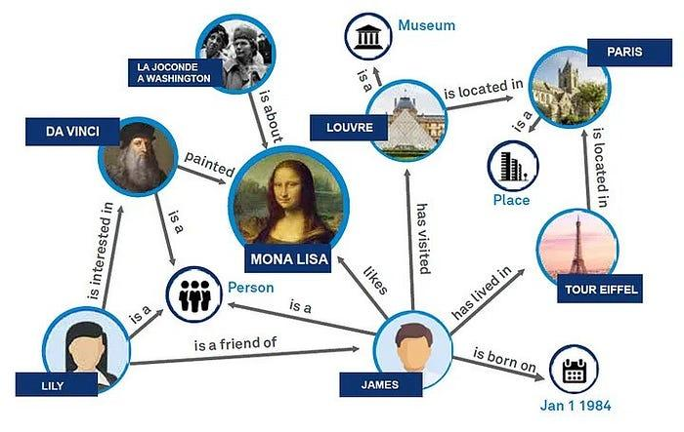
Semantic Relationships
Notes:
One of the strengths of knowledge graphs is their ability to represent semantic relationships between entities. For example, in a healthcare domain, a knowledge graph can represent that a particular medication treats a specific condition, and that condition is a symptom of a broader disease. These relationships provide rich context that can be leveraged by LLMs to generate more informed responses.
By capturing these semantic relationships, GraphRAG enables the system to understand the deeper connections between entities, leading to more accurate and contextually relevant responses.

Slide 10
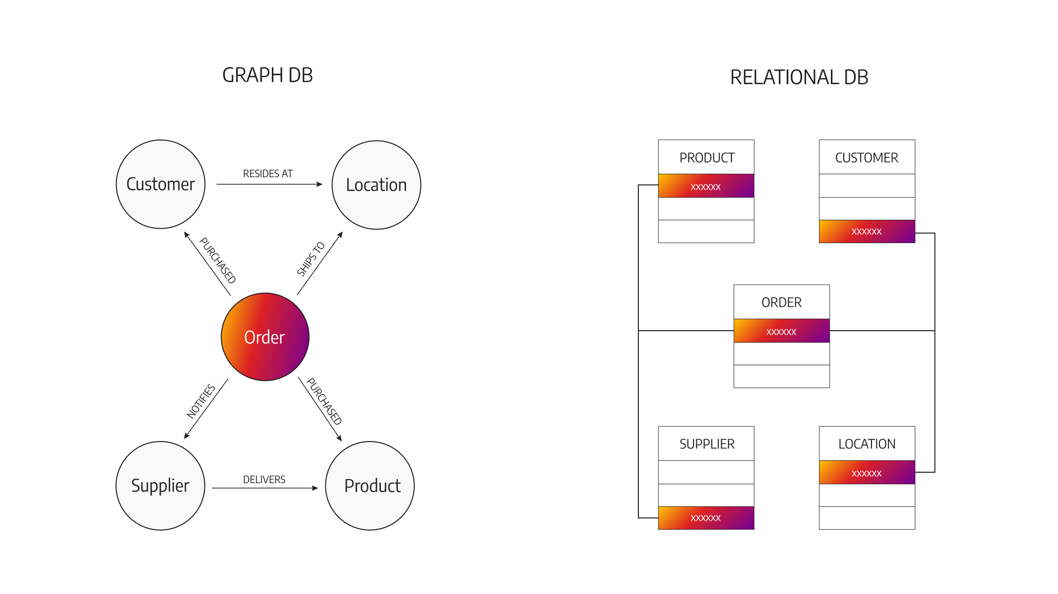

Slide 11
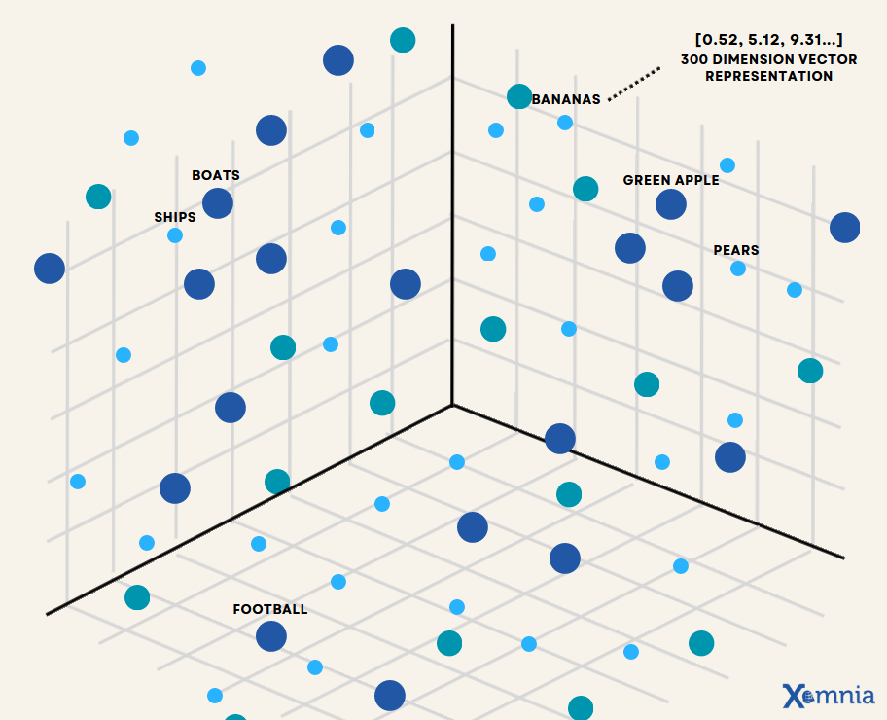

Slide 12
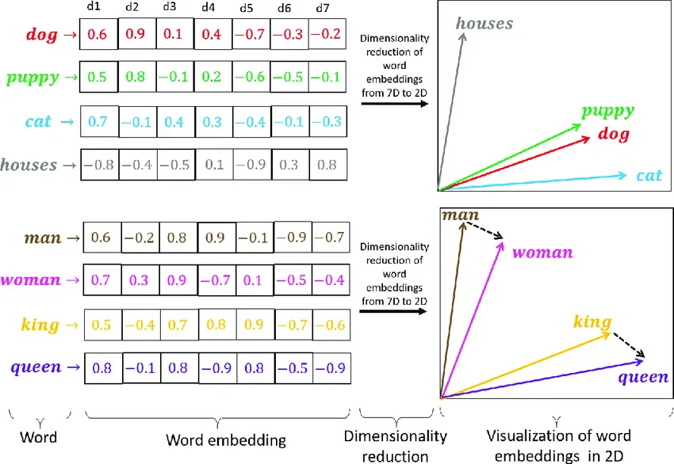

Slide 13
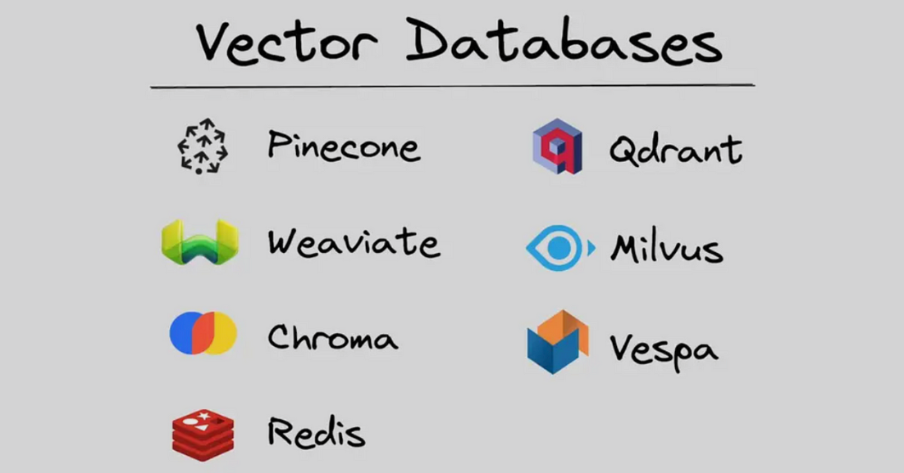

Slide 14
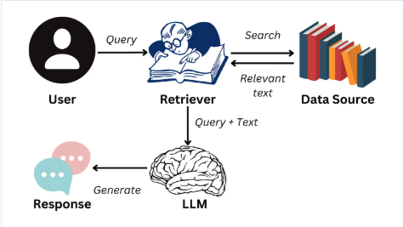
RAG (Retrieval Augmented Generation)

Slide 15
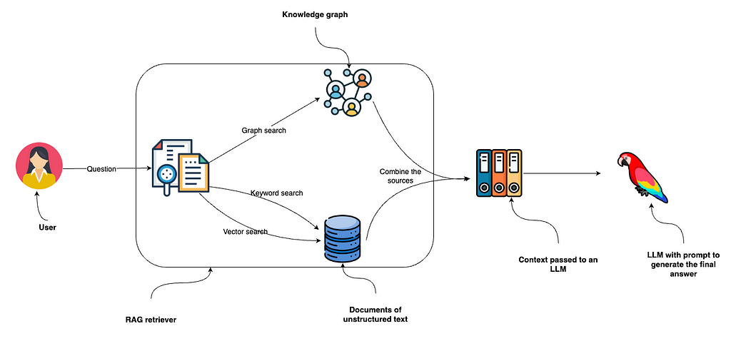

Slide 16
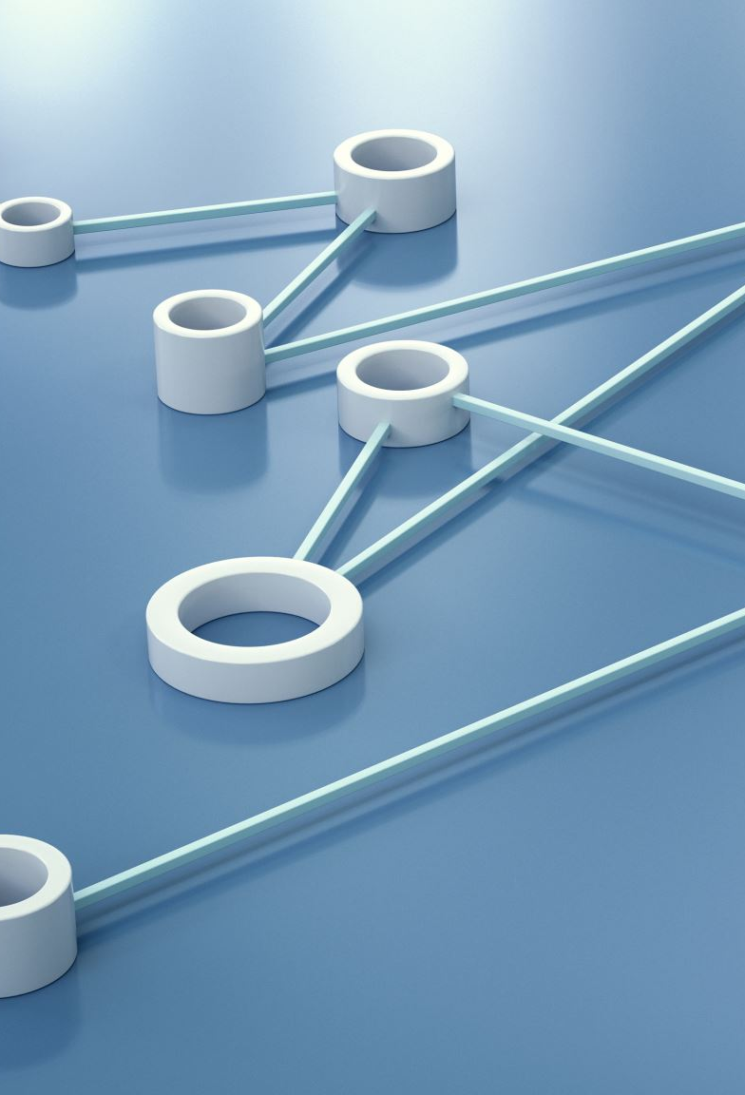
langchain
LangChain is a framework that helps build applications using large language models (LLMs) like ChatGPT.
It makes it easy to connect LLMs with data, tools, and workflows.
You can use it to create chatbots, AI assistants, data-analysis tools, and more.
It allows you to chain together different steps — for example:
Get user input |
Process with an LLM |
Fetch data |
Generate a final answer.
Helps developers combine multiple AI tasks (like searching, summarizing, and reasoning) into one pipeline.

Slide 17

Pre-requiste
A laptop with a stable internet connection
A free Google Collab account
Groq API keys
Neo4j AuraDB instance with API keys
Qdrant Cloud instanced with API keys

Slide 18

installations
No installation required if you use Cloud setup otherwise required VS Code + Python 3.12/3.13, Devcontainer VS plugin and Docker installed.

Slide 19

Cypher quires

Slide 20
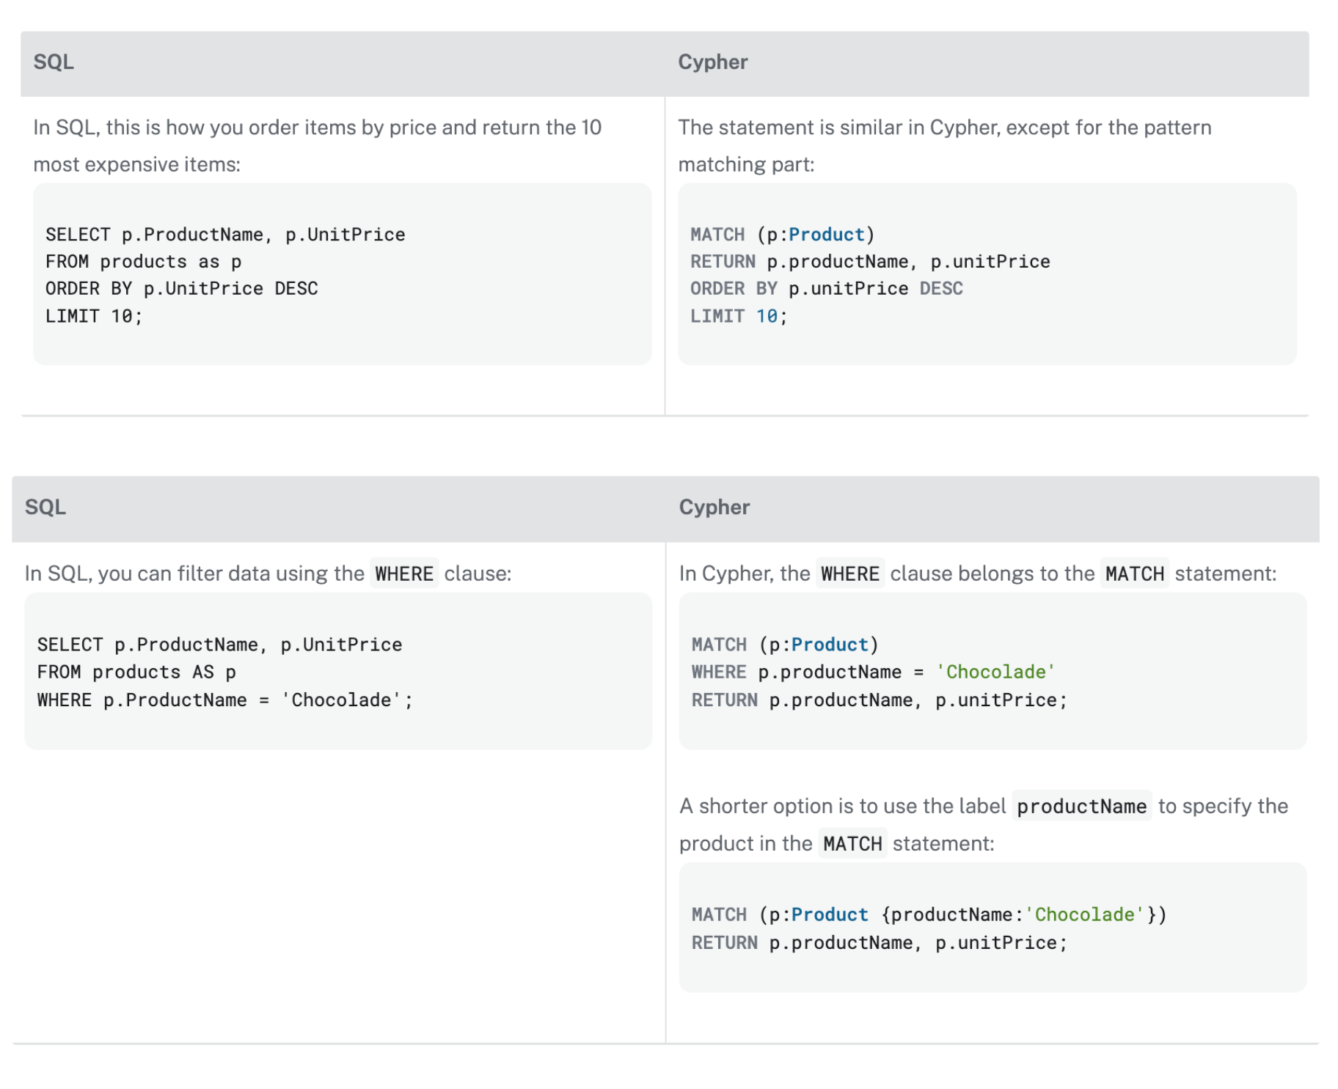
SQL vs Cypher

Slide 21
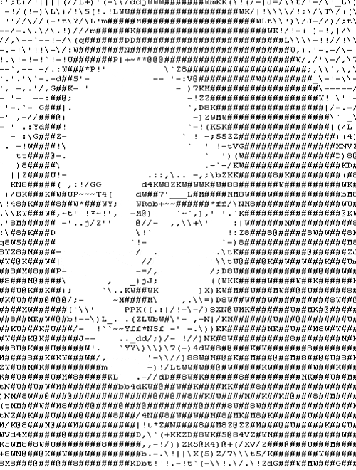
Guess?

Slide 22
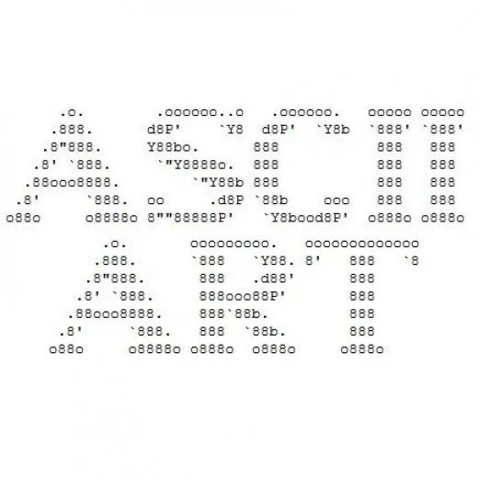

Slide 23
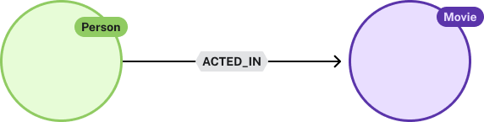
Cypher is pattern matching with ASCII-art

Slide 24
Cypher is pattern matching with ASCII-art
(
)
(
)

Slide 25
Cypher is pattern matching with ASCII-art
( :Person)
( :Movie)

Slide 26
Cypher is pattern matching with ASCII-art
( :Person)-
->( :Movie)

Slide 27
Cypher is pattern matching with ASCII-art
( :Person)-[ :ACTED_IN]->( :Movie)

Slide 28
Cypher is pattern matching with ASCII-art
(a:Person)-[r:ACTED_IN]->(m:Movie)

Slide 29
Filtering results
(a:Person)-[r:ACTED_IN]->(m:Movie) a.name = 'Tom Hanks'

Slide 30
Controlling outputs
(a:Person)-[r:ACTED_IN]->(m:Movie) a.name = 'Tom Hanks'
a.name, m.title movieTitle, r.roles
roles

Slide 31
The CREATE clause
The CREATE clause creates a pattern in the graph
(p:Person {name: "Adam"})
(c:Company {name: "Neo4j"})
(p)-[:WORKS_FOR]->(c)

Slide 32
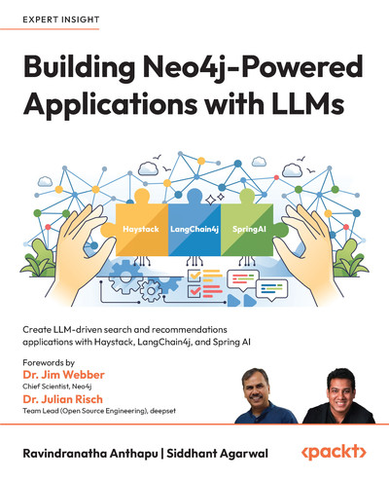
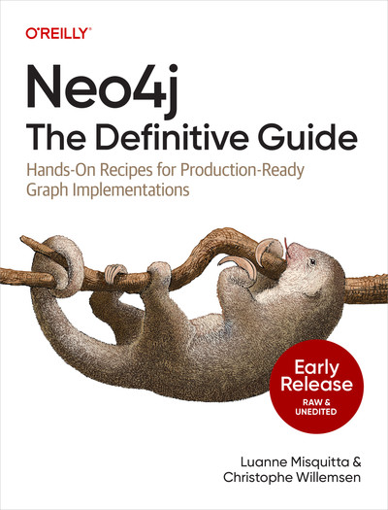

RECOMMENDED READINGS

Slide 33

WORKSHOP
https://bit.ly/WSNEO4J
Wifi password : osi@ws25

Slide 34

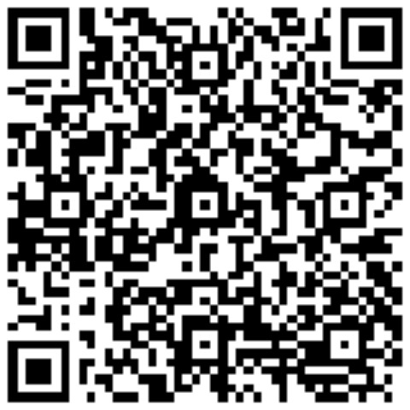
Q&A
LinkedIn

Slide 35

THANK YOU
LinkedIn

